Slide 1
Final Project

Slide 2
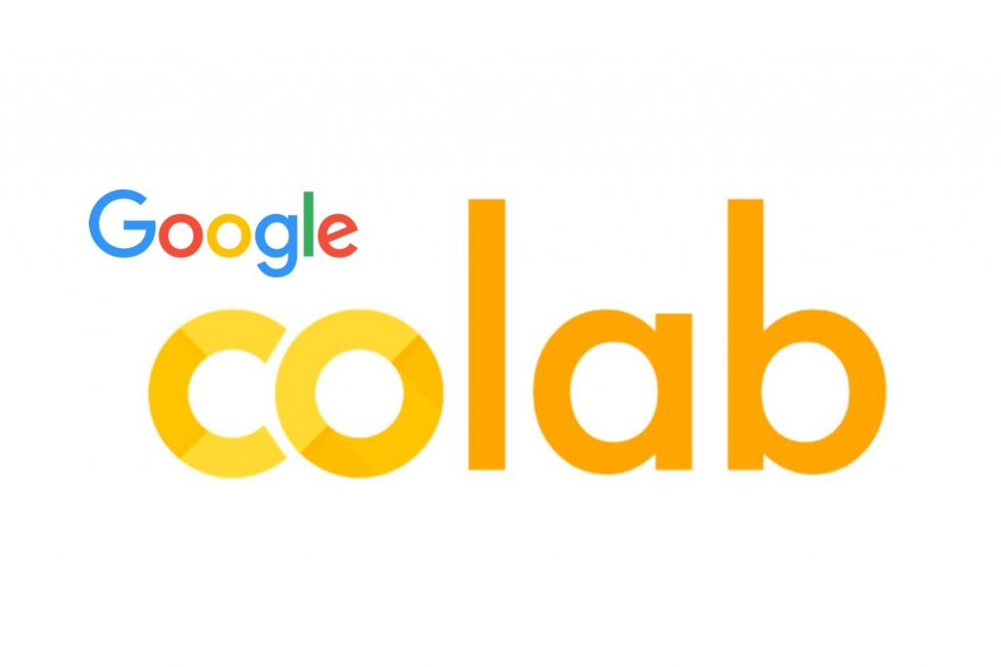
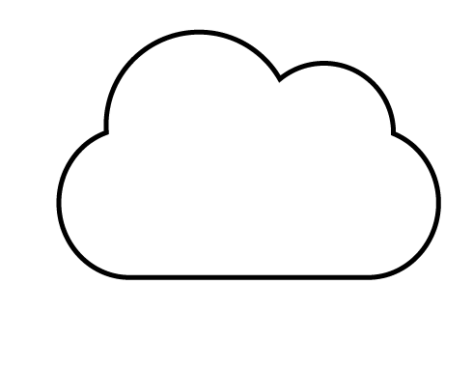
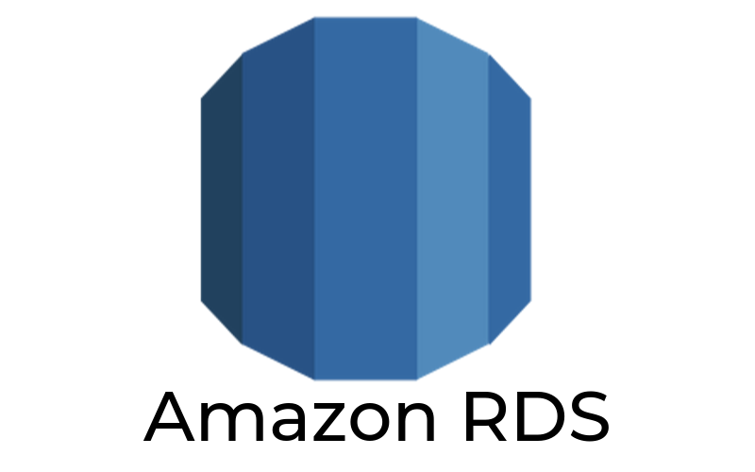
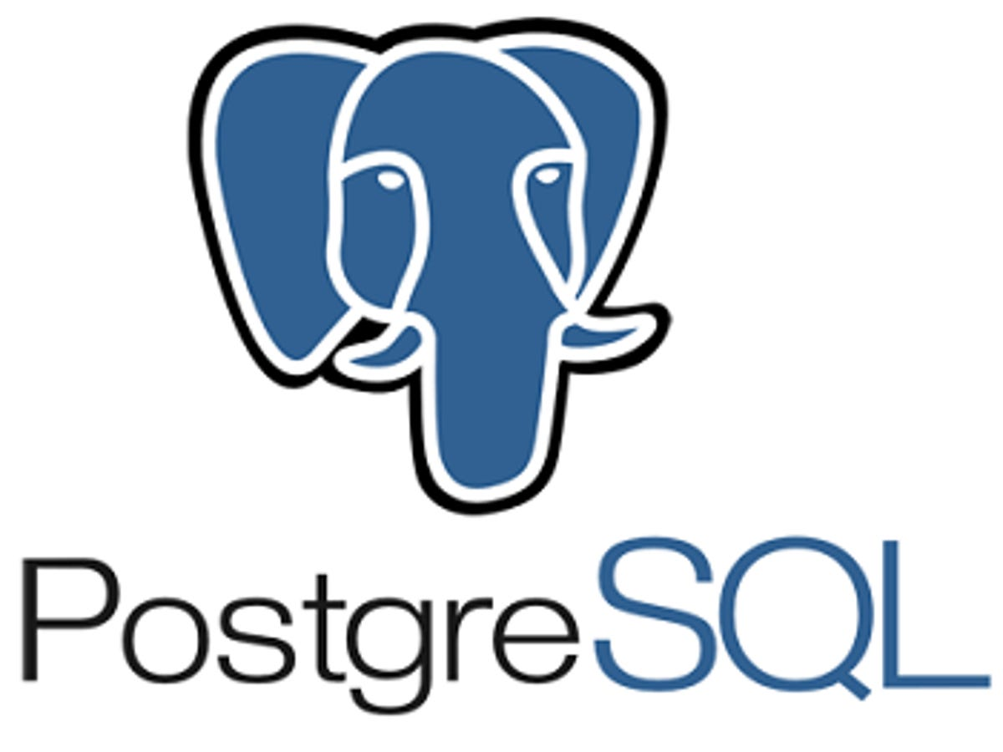




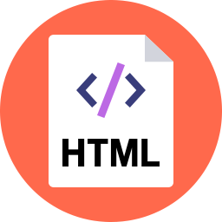

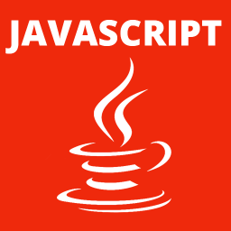

High - Level Architecture Draft
Lydia
Lev
API
Atlas Free
Heroku
DB
ETL
Lev
Muhammad
ML
VIZ
API

Slide 3
Back Up

Slide 4
Technologies
Data Cleaning & Analysis
Pandas
PySpark
Java Script
Database
PostgreSQL
MongoDB
SQLite
Data Storage / Hosting
AWS
Local DB
Google Collab
https://www.geeksforgeeks.org/how-to-run-flask-app-on-google-colab/
https://aws.amazon.com/getting-started/hands-on/serve-a-flask-app/#:~:text=Complete%20the%20following%20prerequisites%20before,t%20have%20some%20of%20those.
Machine Learning
Sci Kit Learn
Tensor Flow
Visualization
Java Script
Tableau
Flask Web Server/ SQLAlchemy

Slide 5
Datasets
https://www.kaggle.com/borismarjanovic/price-volume-data-for-all-us-stocks-etfs
https://www.kaggle.com/dgawlik/nyse
https://www.kaggle.com/zillow/zecon
https://www.kaggle.com/alexgude/california-traffic-collision-data-from-switrs
https://www.kaggle.com/mkechinov/ecommerce-behavior-data-from-multi-category-store
https://www.kaggle.com/qks1lver/amex-nyse-nasdaq-stock-histories
https://www.kaggle.com/cdc/mortality
https://www.kaggle.com/jacksoncrow/stock-market-dataset
https://www.kaggle.com/omermetinn/tweets-about-the-top-companies-from-2015-to-2020
https://www.kaggle.com/tsaustin/us-historical-stock-prices-with-earnings-data

Slide 6
APIs
https://polygon.io/stocks?gclid=CjwKCAiAl-6PBhBCEiwAc2GOVJ_kEIIk8hJVVdiiSLZCXyfZVNIIA1tNJ2O4yXhezFqRARV6ElQSqxoC5qAQAvD_BwE#stocks-product-cards
https://pypi.org/project/yfinance/
https://www.yahoofinanceapi.com/tutorial#:~:text=Is%20Yahoo%20Finance%20API%20available,option%20chains%20and%20market%20analysis.
https://rapidapi.com/hub
https://support.google.com/docs/answer/3093281?hl=en
https://iexcloud.io/
https://www.alphavantage.co/
https://www.worldtradingdata.com/

Slide 7
ML Questions
What are we going to predict / classify:
Stock trend?
Stock price?
Time horizon?
Which features we can use:
Price history?
Volume history?
Stock fundamentals?
Macroeconomic metrics?
Something else?

Slide 8
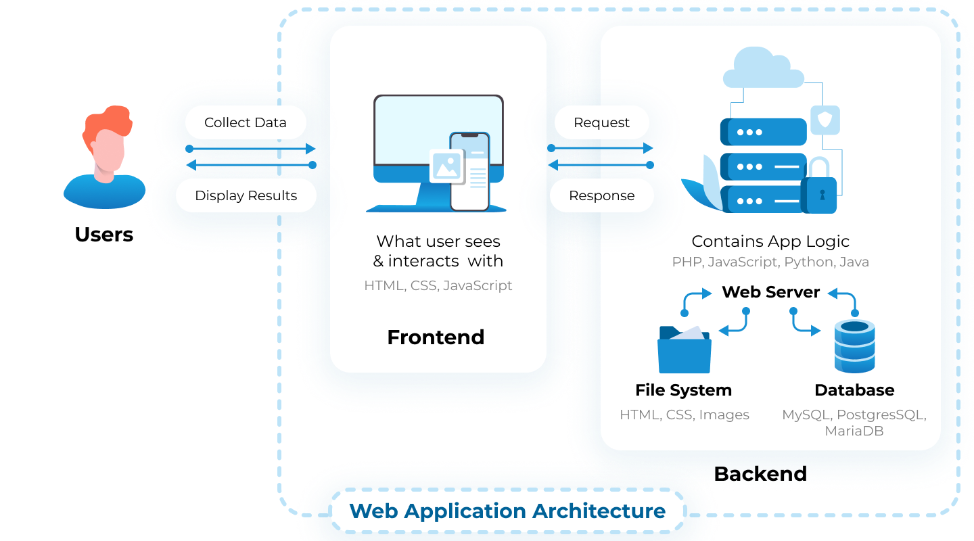
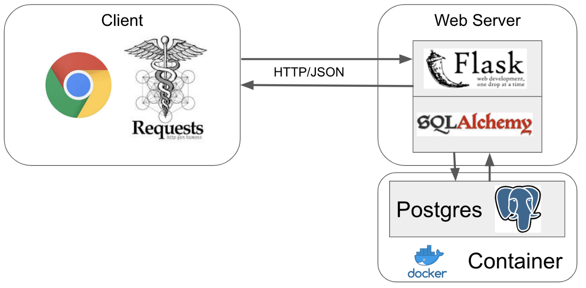
High - Level Architecture Examples
Source:
https://litslink.com/blog/web-application-architecture
Source: https://medium.com/featurepreneur/introduction-to-micro-web-framework-flask-78de9289270b

